Slide 1
A Study of TaBPFN as Surrogate Model in Bayesian Optimization
By: Ocean Wang
Supervised by: Professor E. Raponi
Leiden Institute of Advanced Computer Science (LIACS)
April 24, 2025

Slide 2
Outline
Research Background
Bayesian Optimization
Traditional Surrogate Model GP
TabPFN: A New Approach
Research Question
Methodology
Current Progress
Next Steps
Questions

Slide 3
Research Background
Bayesian Optimization (BO): A machine learning-based approach for optimizing expensive
black-box functions
Key Applications:
Hyperparameter tuning in ML algorithms
Experimental design
Simulator calibration
Materials discovery
Current Limitation: Traditional surrogate models have drawbacks
Opportunity: Exploring alternative surrogate models with improved properties

Slide 4
Bayesian Optimization
Sequential strategy for global optimization of black-box functions
Components:
Surrogate model: Approximates the objective function
Acquisition function: Determines next evaluation point
Particularly effective for expensive-to-evaluate functions

Slide 5
Traditional Surrogate Model GP
Gaussian Process (GP) Regression:
Currently the standard approach in BO
Advantages:
  Provides uncertainty estimates
  Works well with limited data
Limitations:
  Struggles with non-stationary functions
  Poor scaling to high dimensions
  Requires careful kernel design

Slide 6
TabPFN: A New Approach
Tabular Prior-Data Fitted Network:
Recent breakthrough in tabular learning
Pre-trained transformer that uses in-context learning
Single forward pass approximates Bayesian inference
Updated version (2024) supports:
  Up to 10,000 samples
  Up to 500 features
  Regression tasks

Slide 7
TabPFN: Key Features
Dual-attention mechanism:
One for feature interactions
One for sample relationships
Advanced prior:
Combines principles from Structural Causal Models
Incorporates Bayesian Neural Networks
Fast inference: No training required for each new dataset

Slide 8
Research Question:
How effectively does TabPFN perform as a surrogate model for Bayesian Optimization in regression tasks when evaluated on standardized benchmarks?
Focus areas:
Performance across different objective function landscapes from BBOB
Computational efficiency
Scaling with increasing problem dimensionality

Slide 9
Methodology
Three-phase approach:
Implementation:
  Setup TabPFN as surrogate model in BO framework
  Define evaluation metrics
Experimentation:
  Benchmark using BBOB test suite in COCO environment
  Measure key performance metrics
Analysis:
  Statistical comparison with existing methods
  Evaluate effectiveness and efficiency

Slide 10
BBOB Test Suite
Black-Box Optimization Benchmarking (BBOB):
Standardized framework for gradient-free optimization
24 noiseless test functions with different properties:
  Separable functions
  Functions with low/moderate conditioning
  Unimodal functions
  Multi-modal functions
  Weak/strong global structure

Slide 11
Current Progress
Preliminary literature review
Established development environment using Bo-Torch implementation
Created visualization framework for surrogate model comparison
Implemented comparative code for:
  Standard GP regression with Matern kernel
  TabPFN regression with uncertainty visualization
  Surrogate model performance on BBOB test functions

Slide 12
Visualization: GP vs TabPFN
Generated "sausage plots" for both surrogate models:
  Confidence intervals with multiple uncertainty bands
  Performance on 1D test functions
Implemented Bayesian optimization process visualization:
  Surrogate model updates during optimization
  Acquisition function behavior at each iteration
  Sampling point selection strategy

Slide 13
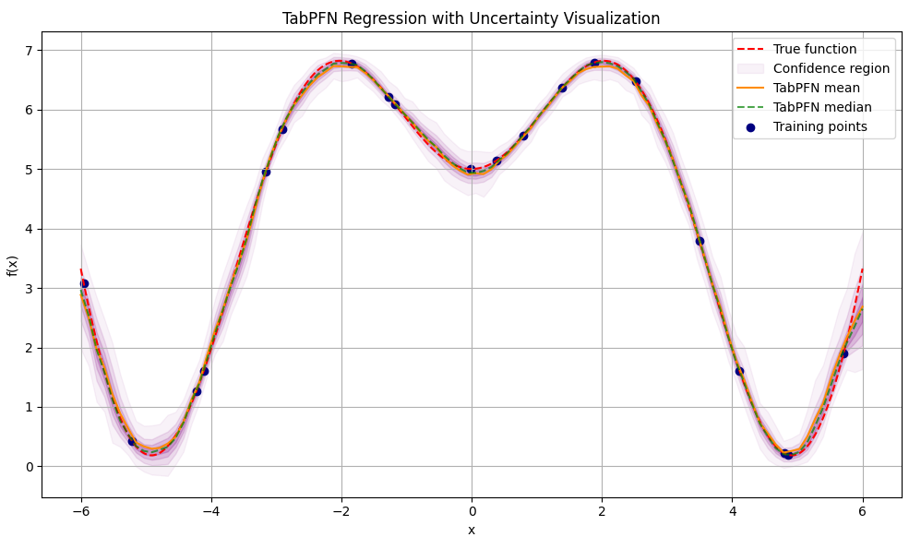
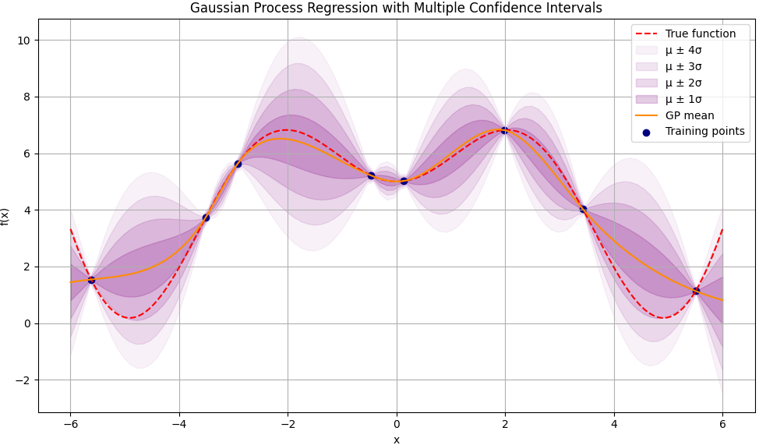
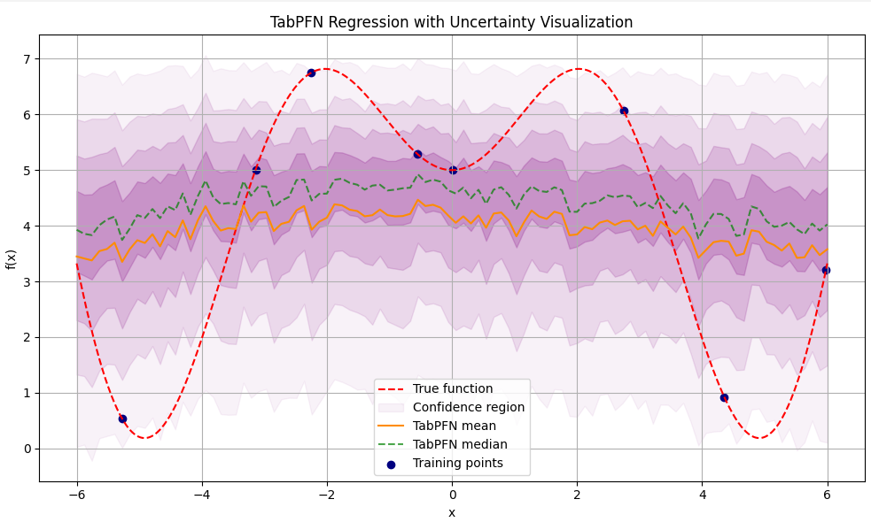
Surrogate Model Comparison

Slide 14
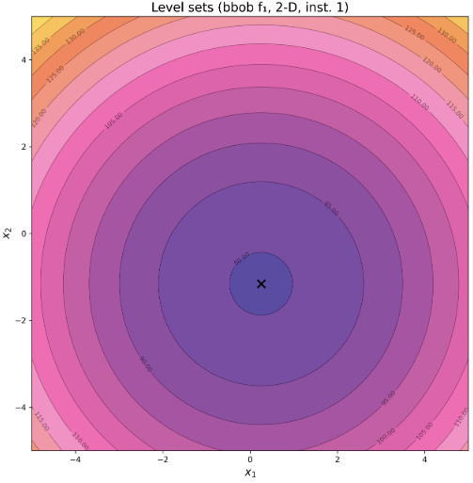
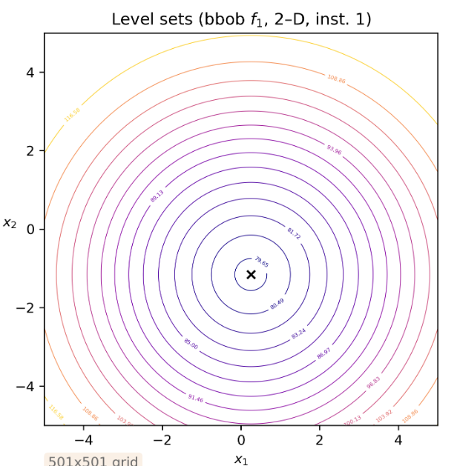
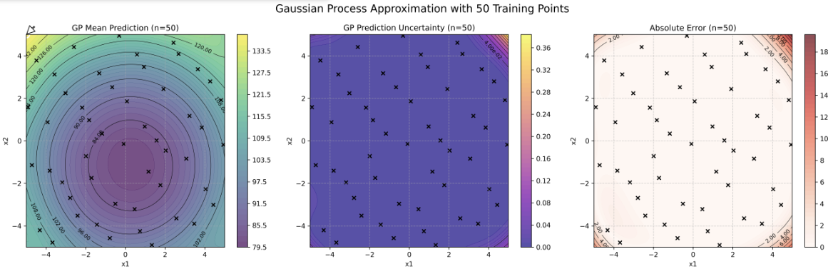
BBOB Test Function Analysis
Created 2D contour plots of BBOB test functions
Implemented GP surrogate fitting with various sample sizes (10-1000)
Generated visualizations of:
  Mean predictions
  Prediction uncertainty
  Absolute error compared to true function

Slide 15
Next Steps
Replace GPR with TabPFN in BO and run on BBOB test suite
Analyze performance across different problem dimensions
Compare computational efficiency against traditional surrogate models
Complete thesis writing with comprehensive analysis

Slide 16
Thank you!
Questions?
Ocean Wang
Bachelor Computer Science & Datascience and Artificial Intelligence
Leiden Institute of Advanced Computer Science (LIACS)

